Slide 1
MSTMC 2024 VPPR Report
Xinglin Yu
2024/11/06
Notes:
Good evening, guys, This is Richard, also Xinglin Yu, from Microsoft Beijing Toastmasters club.
Are you familiar with this QR code? If not, I sincerely invite you to join in it: Our club’s Official Wechat Account: MicrosoftTMC
As the Vice President Public Relations in this club, I have the 1st-hand data about this Wechat account,
I just wanna to recap our club’s past year and share some interesting statistics.
// Had joined the Microsoft Toastmaster club for a year, I learned so much, especially communication ability. So do you, I guess

Slide 2
1. User Analysis
2. Content Analysis
Notes:
User and Content are the 2 analysis aspects that I want to present to you.

Slide 3
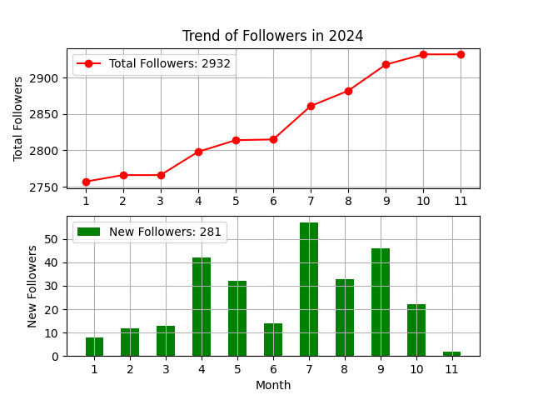
1. User Analysis
Total Followers: 2932
New Followers: 281 (10%),
28 People / Month
Autumn most, Sep. most
Notes:
1st user analysis.
At the end of 2022, we had total followers more than 2500.
Some people may sigh, just so so, what to be proud of.
But if you have an idea that there is only about 3000 employees in Microsoft Beijing site.
This number looks so considerable.
Plus, the year increase of new followers is about 640, which accounts for 25%.
If converting to month increase, it’s 53 people per month.
This is really a stable increasing trend, right? At least, more stable and faster than my salary growth rate
From the trend, Autumn (especially September) is the time when people are most willing to take part in meetings.
Maybe for the comfortable weather, or for the good COVID-19 situation, or for the new joined staffs especially from school enrollment
// Shouldn't we have a round of applause at this proud result?
// This trend has absolutely outpaced the Nasdaq index, exceeded the Microsoft stock trend, surpassed the growth of the Chinese or American economies, and also went beyond the growth of most individual wages
// A good brand centers on customer, they say customer is God; and A good account focus on users, followers represent its health.

Slide 4
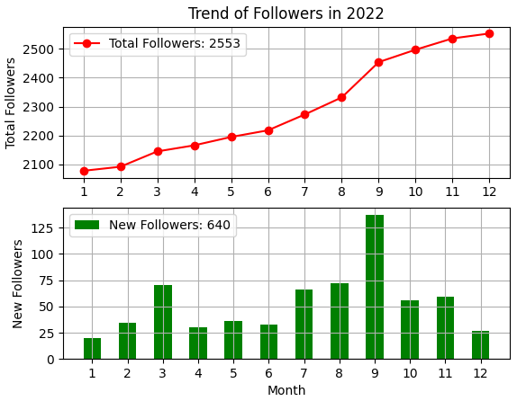
1. User Analysis
Total Followers: 2553
New Followers: 640 (25%),
53 People / Month
Autumn most, Sep. most
Notes:
1st user analysis.
At the end of 2022, we had total followers more than 2500.
Some people may sigh, just so so, what to be proud of.
But if you have an idea that there is only about 3000 employees in Microsoft Beijing site.
This number looks so considerable.
Plus, the year increase of new followers is about 640, which accounts for 25%.
If converting to month increase, it’s 53 people per month.
This is really a stable increasing trend, right? At least, more stable and faster than my salary growth rate
From the trend, Autumn (especially September) is the time when people are most willing to take part in meetings.
Maybe for the comfortable weather, or for the good COVID-19 situation, or for the new joined staffs especially from school enrollment
// Shouldn't we have a round of applause at this proud result?
// This trend has absolutely outpaced the Nasdaq index, exceeded the Microsoft stock trend, surpassed the growth of the Chinese or American economies, and also went beyond the growth of most individual wages
// A good brand centers on customer, they say customer is God; and A good account focus on users, followers represent its health.

Slide 5
1. User Analysis
用户年度增长
 | 2021 | 2022 | 2023 | 2024
Total | 1913 | 2553 | 2651 | 2932
Increase |  | 640 | 98 | 281
Notes:
1st user analysis.
At the end of 2022, we had total followers more than 2500.
Some people may sigh, just so so, what to be proud of.
But if you have an idea that there is only about 3000 employees in Microsoft Beijing site.
This number looks so considerable.
Plus, the year increase of new followers is about 640, which accounts for 25%.
If converting to month increase, it’s 53 people per month.
This is really a stable increasing trend, right? At least, more stable and faster than my salary growth rate
From the trend, Autumn (especially September) is the time when people are most willing to take part in meetings.
Maybe for the comfortable weather, or for the good COVID-19 situation, or for the new joined staffs especially from school enrollment
// Shouldn't we have a round of applause at this proud result?
// This trend has absolutely outpaced the Nasdaq index, exceeded the Microsoft stock trend, surpassed the growth of the Chinese or American economies, and also went beyond the growth of most individual wages
// A good brand centers on customer, they say customer is God; and A good account focus on users, followers represent its health.

Slide 6
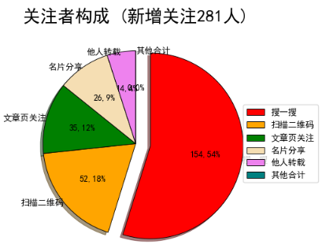
1. User Analysis
2024 年 关注者 构成
1/2: Search, 1/5: Scan, 1/10 Articles
Club Reputation
Notes:
For the new followers,
Near 1/3 is from actively search, 1/4 is from scanning QR code, and 1/5 is attracted by our articles. I am a little surprised for this proportion, I had thought the Scanning QR code would be the 1st and exceeds others a lot, since we posted the QR code in every meeting agenda.
I also feel satisfied with this proportion, at least it demonstrates 2 phenomena:
1) Our club has a good reputation and people is willing to learn about it by actively searching
2) Our articles can attract a large number of audiences

Slide 7
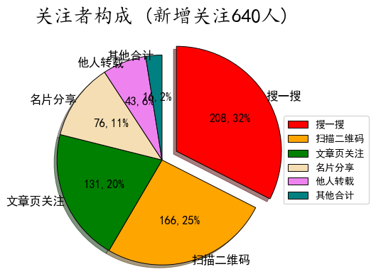
1. User Analysis
2022 年 关注者 构成
1/3: Search, 1/4: Scan, 1/5 Articles
Notes:
For the new followers,
Near 1/3 is from actively search, 1/4 is from scanning QR code, and 1/5 is attracted by our articles. I am a little surprised for this proportion, I had thought the Scanning QR code would be the 1st and exceeds others a lot, since we posted the QR code in every meeting agenda.
I also feel satisfied with this proportion, at least it demonstrates 2 phenomena:
1) Our club has a good reputation and people is willing to learn about it by actively searching
2) Our articles can attract a large number of audiences

Slide 8
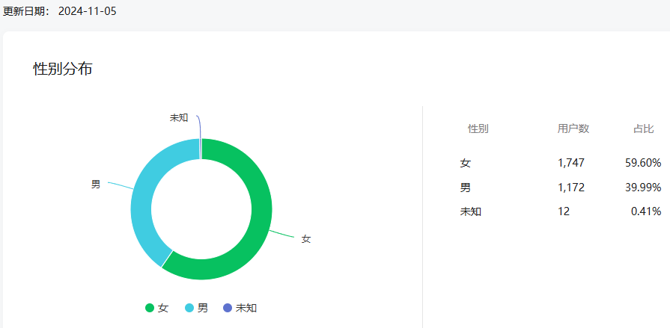
1. User Analysis
Notes:
For the total followers,
The female is a little more than male, they have ratio of roughly 6 VS 4.

Slide 9
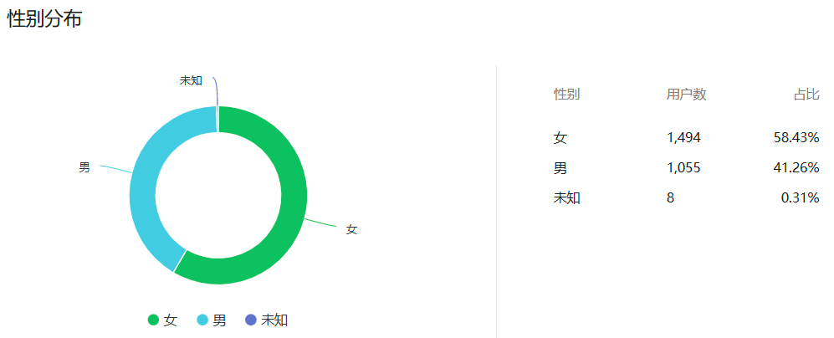
1. User Analysis
数据截止 2023.01.01
Notes:
For the total followers,
The female is a little more than male, they have ratio of roughly 6 VS 4.

Slide 10
2. Content Analysis
Metric | Number
2024 Meetings | x
2024 Published Articles | 35
2024 Total Reading Persons | 12272 (Avg: 351)
2024 Total Reading Times | 18126 (Avg: 518)
Notes:
The 2nd aspect is from content analysis.
In the past year, 43 meetings are held, which produce 47 articles.
Each article is averagely read by 163 people.
And approximately, half the people will read the article more than once.
// But in my observation, less than 30 people are in every meeting. It seems the article attraction has some space to improve.

Slide 11
2. Content Analysis
Metric | Number
2022 Meetings | 43
2022 Published Articles | 47
2022 Total Reading Persons | 7695 (Avg: 163)
2022 Total Reading Times | 11405 (Avg: 242)
Notes:
The 2nd aspect is from content analysis.
In the past year, 43 meetings are held, which produce 47 articles.
Each article is averagely read by 163 people.
And approximately, half the people will read the article more than once.
// But in my observation, less than 30 people are in every meeting. It seems the article attraction has some space to improve.

Slide 12
2. Content Analysis
Top | title | 阅读次数
1 | D88英语即兴演讲冠军 芦涛：《即兴演讲ABC》| 7.17 活动预告 | 546
2 | 7月3日 MSTMC 头马国际俱乐部开放日诚邀您参加 | 509
3 | 04/17 头马会议：两位大区演讲冠军邀您享受演讲的乐趣 | 361
4 | 05/22 头马会议：2024大区演讲冠军邀您攀登故事高峰 | 348
Notes:
The 2nd aspect is from content analysis.
In the past year, 43 meetings are held, which produce 47 articles.
Each article is averagely read by 163 people.
And approximately, half the people will read the article more than once.
// But in my observation, less than 30 people are in every meeting. It seems the article attraction has some space to improve.

Slide 13
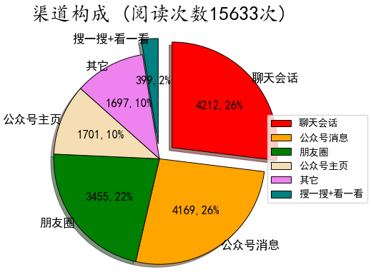
2. Content Analysis
Chat box ≈ Account Message ≈ Moments
≈ 1/4
Group Note before meeting
Recommend > Search
Notes:
Now turn to the Channel Composition
Our articles are mainly read from 3 entrances: Chat box, Account Message and Moments.
They are roughly equal in proportion, which is about 1/4
If you are in our wechat guest group, you will find that: We take a group note before each meeting, Maybe Monday, Tuesday or Wednesday and invite people to attach their names in the attendance list.
This way is proved to be very effective.
Furthermore, all the 3 entrances are classified as passive recommendation, instead of actively search or look for meeting info.
This is normal and understandable in an age of information overload

Slide 14
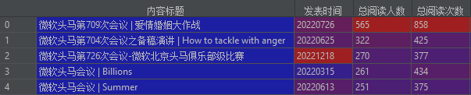

2. Content Analysis
Special meeting + new sessions + Gifts
Top 5 of Total Reading Persons
Joint Meetings
Notes:
The top 5 reading articles are about marriage, emotion, contest, Billions, and summer.
It’s worth noting that: The 1st one with marriage topic is a dedicated and special meeting, with several new wonderful sessions: Talk show, Interview, Impromptu and debate
That meeting surely brought us maximum attentions and attendance, far more than the other normal meetings.
In the last year, We held 3 joint meetings separately with other Toastmaster clubs: CCP, Microsoft Shanghai Toastmasters, and Suzhou Toastmasters.
They all got pretty good attentions, I guess all people in those joint meetings learned a lot about the style and look of other clubs.
// From data, the results were somewhat surprising and unexpected because these meetings didn't lead to more followers or more article readings.

Slide 15
Health !
Club Mission
We provide a supportive and positive learning experience in which members are empowered to develop communication and leadership skills, resulting in greater self-confidence and personal growth.
Three-Body Universe
Make time for Civilization, for civilization won’t make time.
Notes:
In summary, our club was growing up with a health trend last year, and so were our members and guests.
We are continuously fulfilling the Club Mission: to provide a supportive and positive learning experience
I like a sentence from 3-body universe very much: Make time for Civilization, for civilization won’t make time.
I invite you: to take full advantage of the opportunity from Toastmasters
to develop communication and leadership skills, resulting in greater self-confidence and personal growth
给岁月以文明, 而不是给文明以岁月

Slide 16
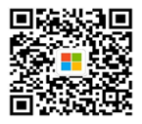
Thanks
Notes:
Thanks for members’ contribution, and what’s more everyone’s actively participation

